Slide 1
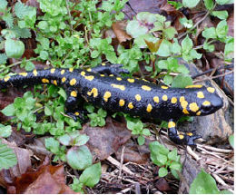
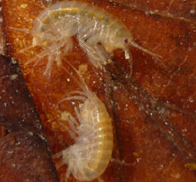
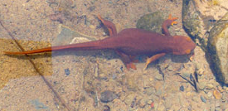
Diversity in riverine metacommunities :
a network perspective
by Florian Altermatt, 2013
Notes:
review --> theoretical models suggesting → the specific structure of the river network directly affects diversity patterns
--> appropriate measures can be used to apply these models to river conservation and restoration (life forest ,grassland)
--> knowledge gaps and future directions for research on this topic

Slide 2
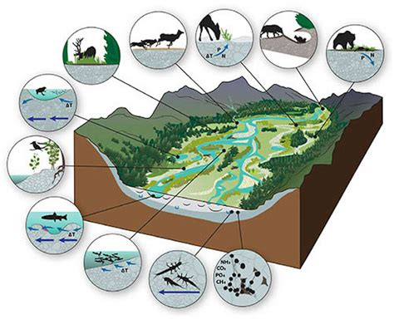
Why is it important to talk about diversity patterns in riverine habitats ?
Biodiversity in freshwater habitats :
support 10% of all known species
specific structure (providing high variety of habitats and ecological corridors)
support river ecosystem services
declines far greater than in terrestrial habitats
(Emily Harrington)
Notes:
<1% of the Earth’s surface, support 10%
Ecosystem services
food, water, regulation and cultural services
Antropogenic stessors → declines in biodiversity are far greater in freshwater
Need to restore, protect,

Slide 3
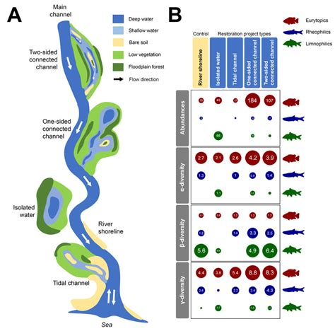
Why is it important to talk about diversity patterns in riverine habitats ?
In Switzerland :
¼ of the swiss rivers need restoration
For a better restoration efficiency :
better understanding of the diversity drivers
requires network perspective
(Stoffers et al., 2022)
Notes:
In Switzerland, ¼ of rivers need restoration
to ensure restauration efficiency --> understand well the drivers of diversity.
complex, at diff scales, multifactoriel --> need for an understanding at a network perspective.

Slide 4


Metacommunity concept definition
dispersal of individuals
local community
connectivity
patch
metacommunity
Notes:
- metacommunity : set of local communities in patches linked by the dispersal of interacting species.
- patches : relatively homogeneous area that differs from its surroundings (Patches are the basic unit of the landscape), local community,
!=
-niche : match of a specie to a specific environment (biotic and abiotic conditions)
- dispersal : movements of individuals (from a birth location to reproduction site)
- connectivity : flow of energy, materials, and organisms across space

Slide 5
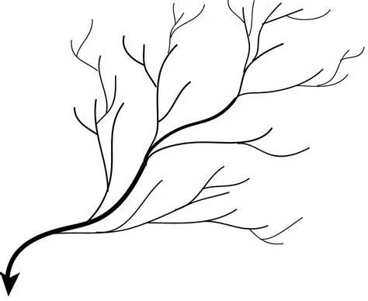
Metacommunity concept in rivers : dendritic structure
dispersal of individuals
connectivity
patch
metacommunity
Notes:
dendritic network : hierarchic networks of nodes and branches
drives the dispersal, connectivity, patch distribution etc.
and that's about this metacommunity dynamics in dendritic structure that we will talk now to understand diversity patterns in rivers

Slide 6
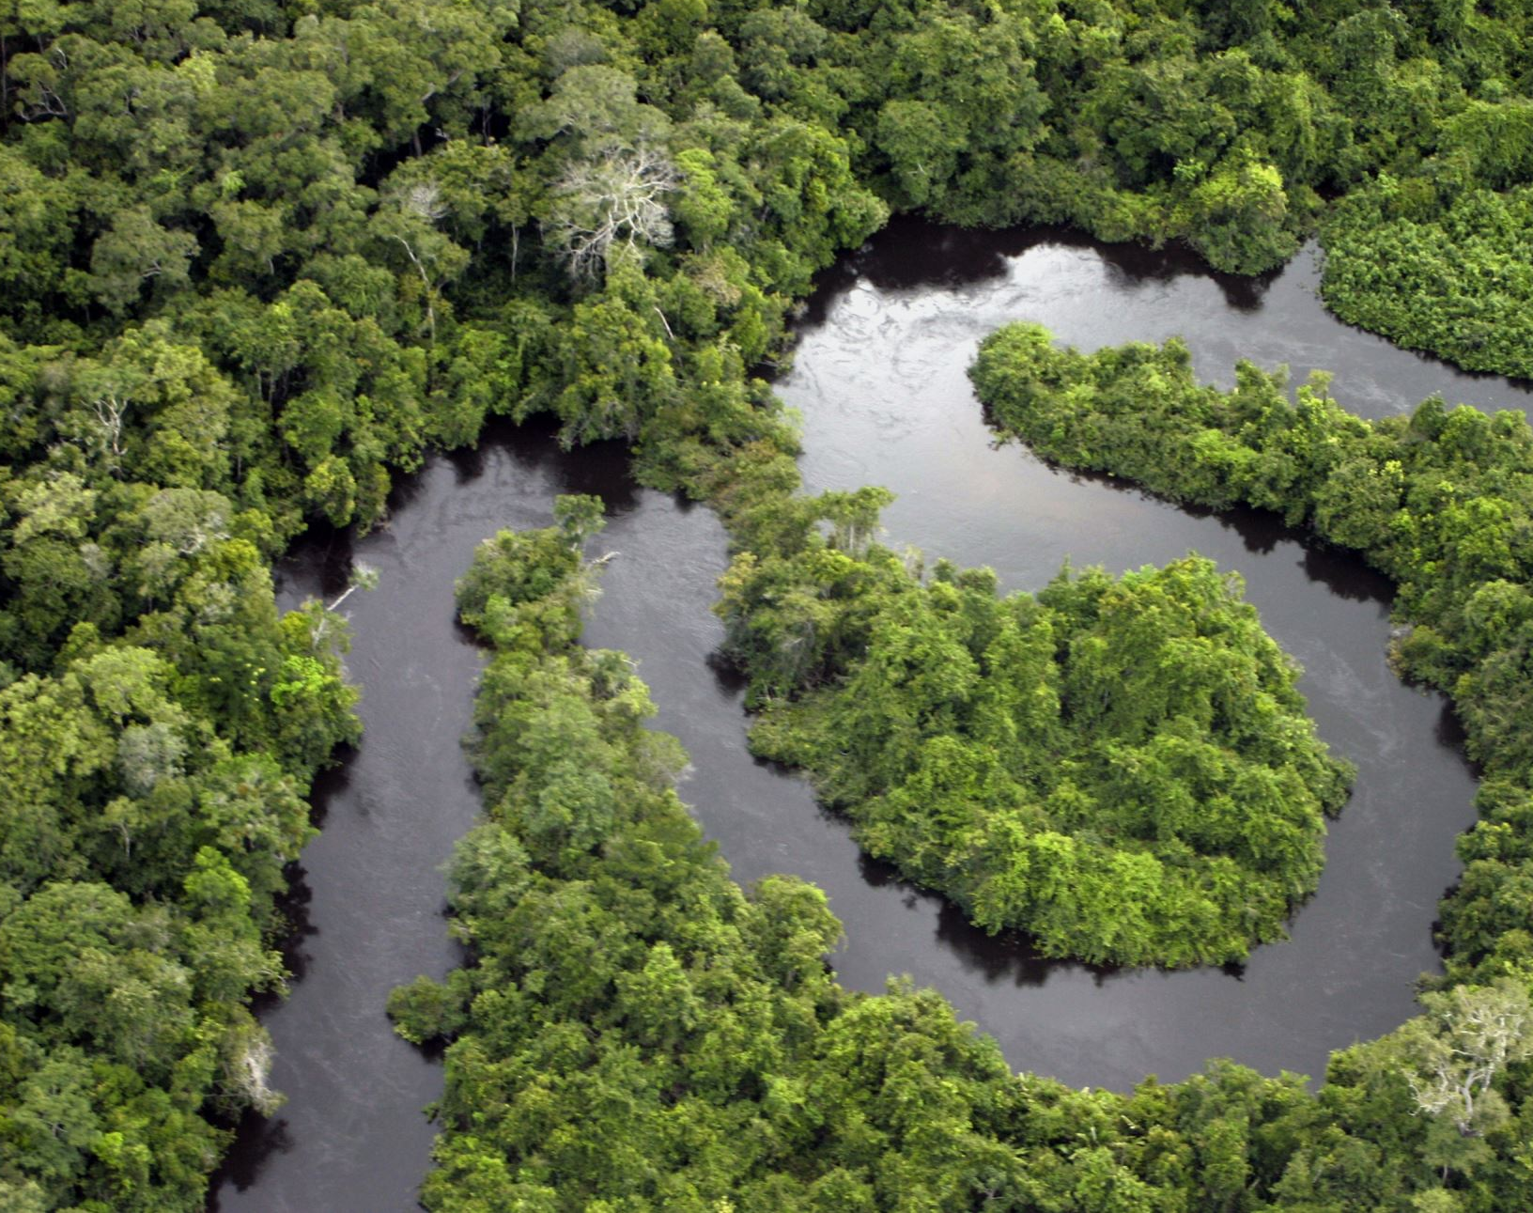
Traditional methods to describe river networks

Slide 7



Metrics: Euclidian VS topological distance
Orders of magnitude differences

Slide 8

Stepping-stone models
1D
Assumption of restricted dispersal along water ways
Demographic patterns differ from reality
Time to extinction is longer in dendritic compared to linear networks (when dispersal is directionally unbiased)

Slide 9
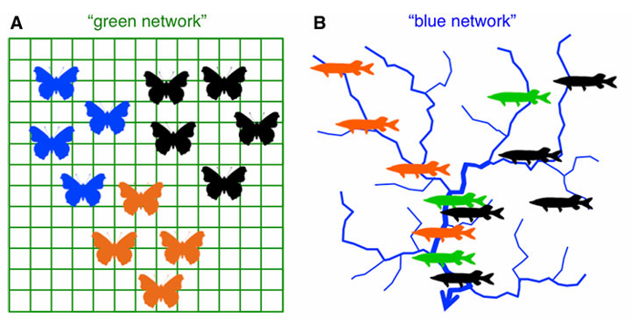
Lattice grids VS dendritic system
Florian Altermatt (2013)

Slide 10
Lattice grids VS dendritic system
Mostly used 2D | Arborescent bifurcation originating from one node and extending out in one direction
Node represents an individual or a community of interacting species | Nodes and branches serve as habitat
Local dispersal occur to the 8 adjacent nodes | Structure and physical flows dictate distance and directionality of dispersal
Dispersal random in direction, and distance varies among species. | Hierarchic

Slide 11
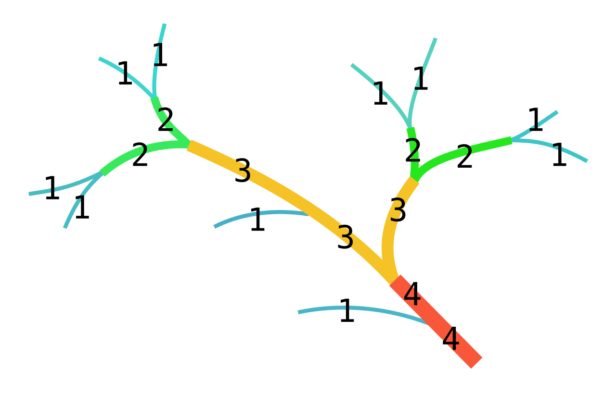
Strahler order classes
1957
Describe the hierarchical position within a river
Increasing size classes
Depends on the scale of the map used
Streams of very different sizes may have the same order
Inconsistent within a river network
Strahler number - Wikipedia

Slide 12
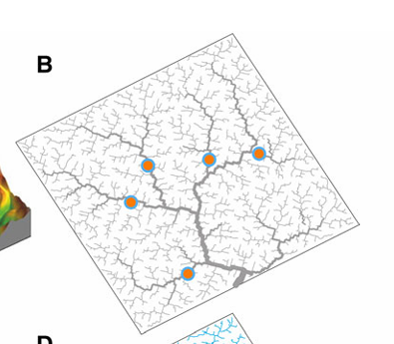
Local perspective
Non-spatial perspective
Local environmental factors
Neglect dispersal processes and connectivity
Incomplete perspective may lead to false conclusions.
Florian Altermatt (2013)

Slide 13
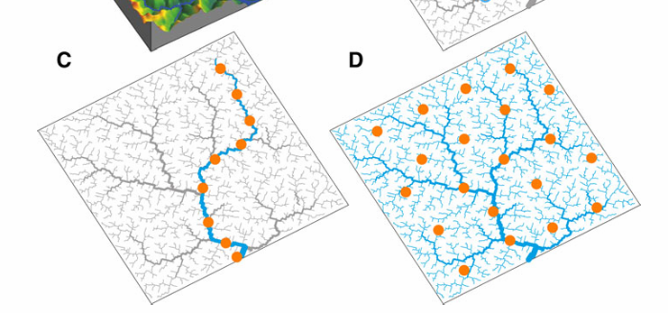
River Continum Concept (RCC)
linear, longitudinal sequence
systematic and gradual change between the production and consumption of organic material, between fauna… from headwaters to mid- and lower reaches
Disproportionately focuses on lower reaches with most head water communities being neglected
Florian Altermatt (2013)

Slide 14
Metacommunity
Florian Altermatt (2013)

Slide 15
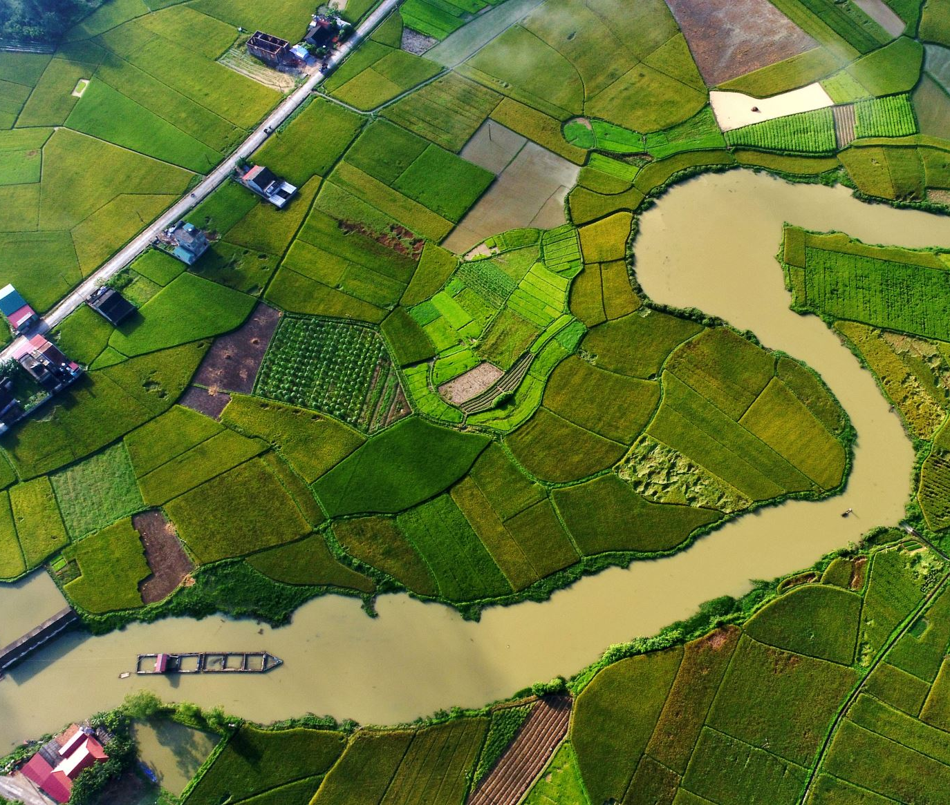
Theoretical models and NEW methods to describe river network and assess its diversity

Slide 16
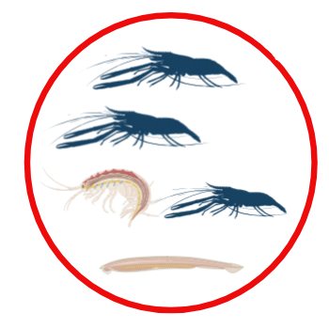
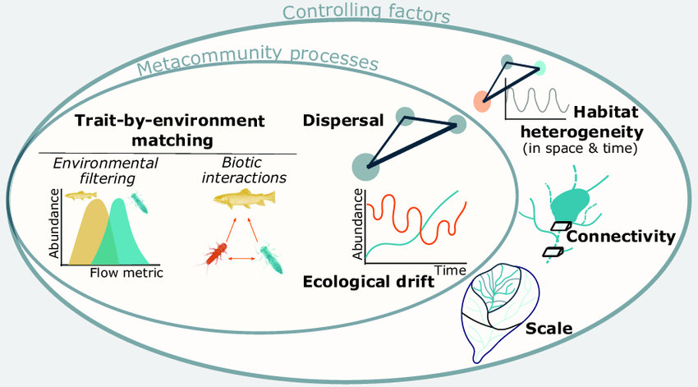
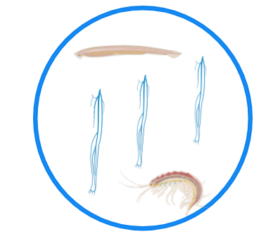
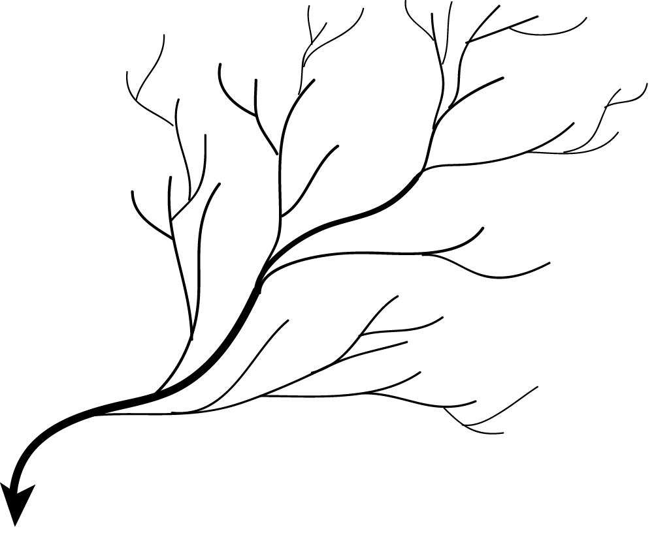
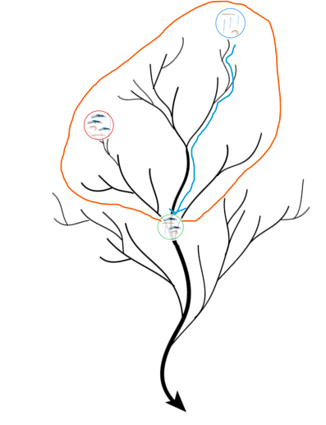
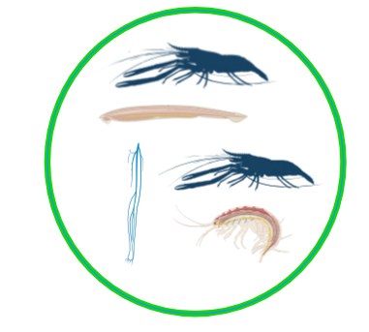
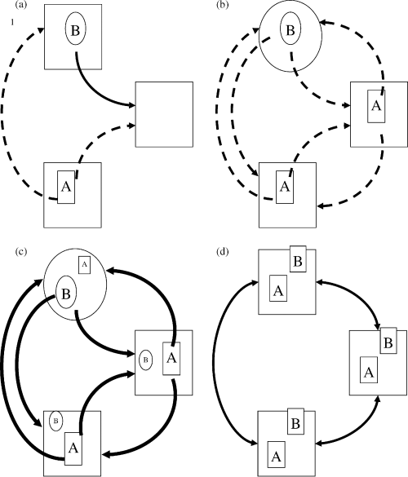
METACOMMUNITY COMPOSITION & DIVERSITY
METACOMMUNITY PROCESSES
CONTROLLING FACTORS
Appropriate metrics
Metacommunity scenarios

Slide 17
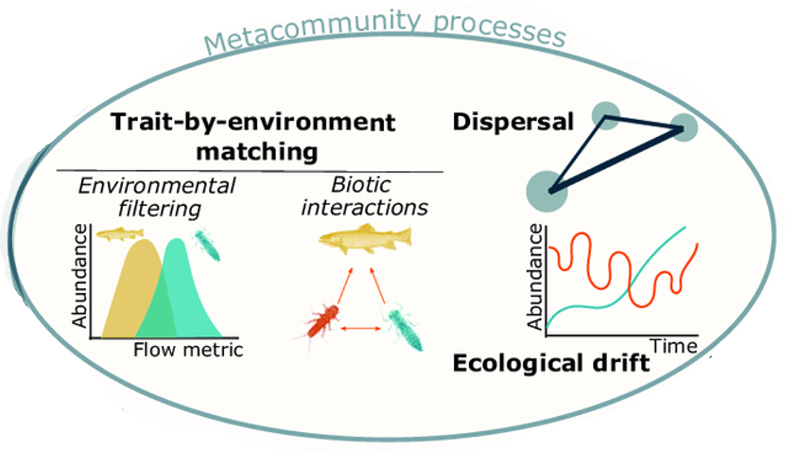

METACOMMUNITY COMPOSITION & DIVERSITY
METACOMMUNITY PROCESSES
CONTROLLING FACTORS
Appropriate metrics
Metacommunity scenarios
Adapted from Messager et al. (2023)

Slide 18
METACOMMUNITY COMPOSITION & DIVERSITY
METACOMMUNITY PROCESSES
CONTROLLING FACTORS
Appropriate metrics
Metacommunity scenarios
Patch dynamics
Species sorting
Identical patchs
Trait-by-environment matching
Dispersal
Biotic interactions
Ecological drift
Mass-effect
Neutral
Dispersal more important than trait-by-environment matching
Ecological drift
Adapted from Leibold (2004)

Slide 19
METACOMMUNITY COMPOSITION & DIVERSITY
METACOMMUNITY PROCESSES
CONTROLLING FACTORS
Appropriate metrics
Metacommunity scenarios
Higly important for a better understanding of diversity in dendritic river networks
Messager et al. (2023)

Slide 20
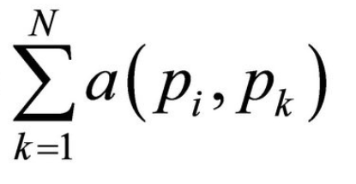


METACOMMUNITY COMPOSITION & DIVERSITY
METACOMMUNITY PROCESSES
CONTROLLING FACTORS
Appropriate metrics
Metacommunity scenarios
Factors to describe = river network caracteristic | Appropriate metrics
Patch size | Upstream catchment area draining into site (proportionnal to mean discharge volume→ depth and width )
Species dispersal potential | Topological distance Directionnality of dispersal
Connectivity | Network centrality: Fareness i = N the number of nodes a (pi,pk) the distance along the shortest path between the nodes pi and pk

Slide 21
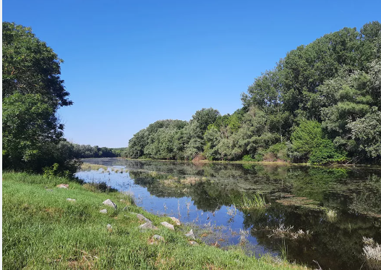
Metacomunity theory result and in practice

Slide 22
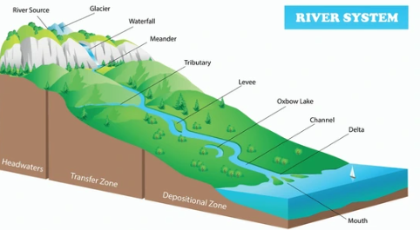
Metacomunity theory result: diversity in rivers systems
Dendritic system
Genetic diversity, heterozygosity and species richness higher in dendritic systems
Migration into headwater limited
Reservoirs for unique alleles
Headwaters: high β, low α-diversity
Notes:
Genetic diversity, heterozygosity and species richness higher in dendritic systems.
Migration into headwater populations limited, such populations can act as reservoirs for unique alleles or competitively inferior species.
Individual headwater populations, are genetically homogeneous within each headwater, but different among headwaters.

Slide 23
Metacomunity theory result: diversity in rivers systems
Connectivity (number of neighbor patches)
Population demography influenced by connectivity
High dispersal: size metacommunity decreases, variance increase
Low dispersal: local extinction and genetic isolation by distance promoted
Limiting factor. Reducing beta-diversity.
Positive effect: dispersal of endangered species.
Negative effect: high risk or pollution or non native species.
Notes:
Population demography influenced by connectivity .
High dispersal: negative influence on metapopulation size while variance in occupied patches increase.
Low dispersal -> local extinction and genetic isolation by distance promoted.
Limiting factor, dispersal links local communities to regional species pool. Reducing beta-diversity.
Positive effect: dispersal of endangered species.
Negative effect: high risk or pollution or non native species.

Slide 24
Metacomunity theory result: diversity in rivers systems
Directional ‘drift’
Species come together at confluences
Affect distribution of actively dispersing organisms (fish).
Negative effect: compensation
Branches and confluence
Species richness highest branches
Species diversity and allelic richness increase at confluences
More isolated patches (branches) than highly connected patches (confluences)
Notes:
Directional ‘drift’
Increase likelihood different species come together at confluences and downstream.
Affect distribution of actively dispersing organisms (fish).
Negative effect on population dynamics : compensation of adult that goes upstream dispersal because larvae goes downstream.
Branches and confluence
Species richness in dendritic system highest intermediate levels of branching structure and species diversity and allelic richness increase at confluences of branches.
More isolated patches (branches) than highly connected patches (confluences) compared to other types of landscapes.

Slide 25
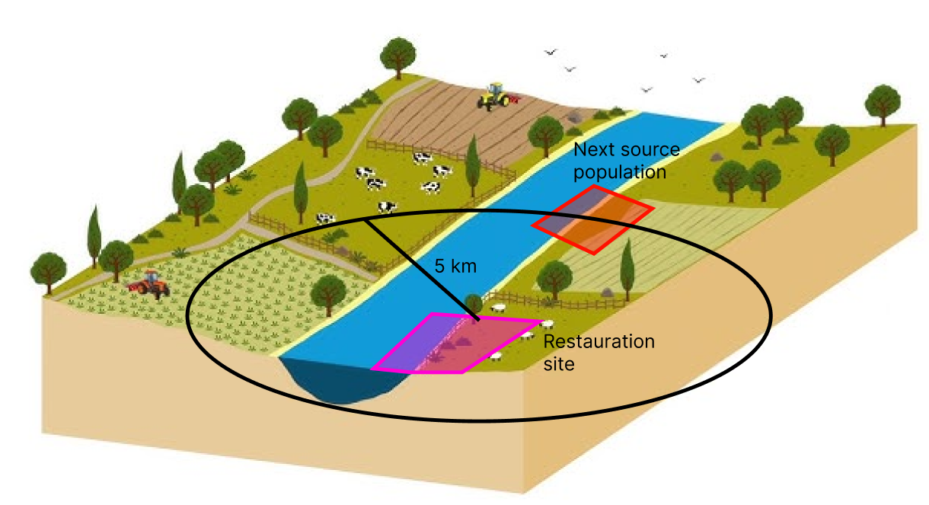
Metacomunity theory in practice: restoration (& conservation?)
Success: connectivity restored site to regional species
Distance to potential source population < 5km
Notes:
The success of the restauration depends on the connectivity restored site to regional species.
The distance to potential source population is crucial.
No more than 5km between restaured site and source population.

Slide 26
Metacomunity theory in practice: restoration (& conservation?)
Identification of central patches
Central patches: passage, allow fast colonisation
Patch with high centrality : maximize spread of reintroduced species
Prevent species colonizing to get close from the nodes.
Central patch
Notes:
Identification of patches and communities that are central is important.
Central patches can be managed to be a stepping stone (passage), and allow fast colonization after retauration.
Patch with high centrality : maximize spread of reintroduced species or functioning of restored site as source pop.
Measures against non-native species: prevent species colonizing nodes to get close from the nodes.

Slide 27

Knowledge gaps and questions to answer

Slide 28
Knowledge Gaps
Drivers of community composition and diversity patterns are still disputed (ex: diversity pattern of actively dispersing freshwater organisms).
Few studies that sampled headwaters, intermediate branches and main rivers. Need to extend these to further river networks (including tropical system and anthropogenic river alterations).
Few studies about the effect of dendritic structure of habitats on invasion success.

Slide 29
Questions to answer
Effect of different dispersal rates or dispersal directionalities on diversity and community composition.
Low local diversity, α, always complemented with high β diversity between headwaters ?

Slide 30

Take home message
Many studies on diversity in riverine ecosystems are, however, still focusing on a local perspective, ignoring dispersal and the specific network connectivity.

Slide 31
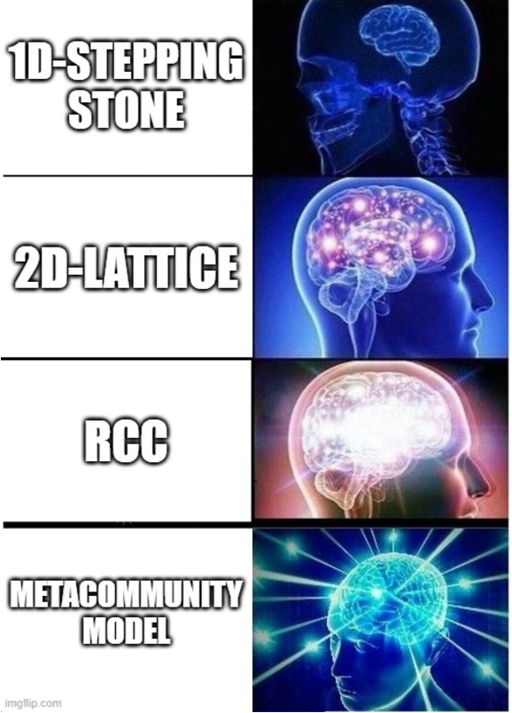
Questions ?

Slide 32
References
Leibold, M. A., Holyoak, M., Mouquet, N., Amarasekare, P., Chase, J. M., Hoopes, M. F., Holt, R. D., Shurin, J. B., Law, R., Tilman, D., Loreau, M., & Gonzalez, A. (2004). The metacommunity concept: a framework for multi‐scale community ecology. Ecology Letters, 7(7), 601–613. https://doi.org/10.1111/j.1461-0248.2004.00608.x
Messager, M. L., Olden, J. D., Tonkin, J. D., Stubbington, R., Rogosch, J. S., Busch, M. H., Little, C. J., Walters, A. W., Atkinson, C. L., Shanafield, M., Yu, S., Boersma, K. S., Lytle, D. A., Walker, R. H., Burrows, R. M., & Datry, T. (2023). A metasystem approach to designing environmental flows. BioScience, 73(9), 643–662. https://doi.org/10.1093/biosci/biad067
Allan, J. D., Castillo, M. M., & Capps, K. A. (2021). Rivers in the Anthropocene. Dans Springer eBooks (p. 1‑17). https://doi.org/10.1007/978-3-030-61286-3_1
Wikipedia contributors. (2024, October 13). Strahler number. Wikipedia. https://en.wikipedia.org/wiki/Strahler_number
Stoffers, T., Buijse, A., Geerling, G., Jans, L., Schoor, M., Poos, J., Verreth, J., & Nagelkerke, L. (2022). Freshwater fish biodiversity restoration in floodplain rivers requires connectivity and habitat heterogeneity at multiple spatial scales. The Science Of The Total Environment, 838, 156509. https://doi.org/10.1016/j.scitotenv.2022.156509
Altermatt, Florian. (2013). Diversity in riverine metacommunities: A network perspective. Aquatic Ecology. https://www.researchgate.net/publication/262867832_Diversity_in_riverine_metacommunities_A_network_perspective

